Slide 1

ADAPTATION OF PLANTS TO HIGH TEMPERATURE
Presented by Group 6
1

Slide 2
OUTLINE
Introduction.
Impacts of High Temperatures on Plants
Physiological Adaptations of Plants
Behavioral Adaptations of Plants
Structural Adaptations of Plants
Examples of Plants adapted to High temperature
Conclusion
2

Slide 3
Introduction
Adaption of plants to high temperatures refers to changes in structure, physiology, and behavior enabling them to thrive in such environments
High temperature stress occurs when plants experience prolonged periods of elevated temperatures beyond their tolerance limits.
3

Slide 4
Impacts of High Temperature on Plants
Plants can operate most of its physiological process normally in the range of 0-40℃
High temperature stress >40 ℃ causes injury to the plant
The degree and duration of exposure also increase the effect on plant.
Impacts of high temperature stress include reduced photosynthesis, oxidative stress, cellular membrane damage, protein denaturation, and disruption of water balance.
4

Slide 5
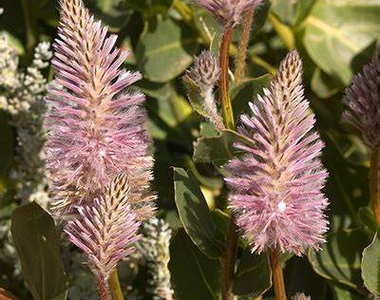
Physiological Adaptations
Osmotic adjustment
Heat shock proteins (HSPs)
Enhanced root growth
Hormonal changes
Fig.1 Ptilotus exaltatus
5

Slide 6
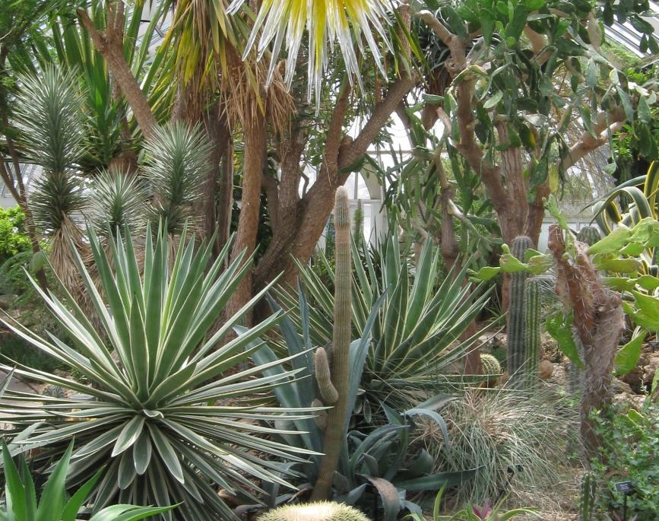
Behavioral Adaptations
Leaf movements
Canopy architecture
Phenological shifts
Root proliferation and depth adjustment
Fig.2 Arid Ecosystem with canopy architecture
6

Slide 7

Structural Adaptations
Leaf modifications
Protective tissue layers
Stem modifications
Root adaptation
Fig. 3 Opuntia cactus
7

Slide 8
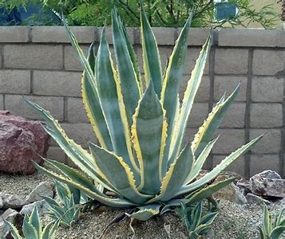
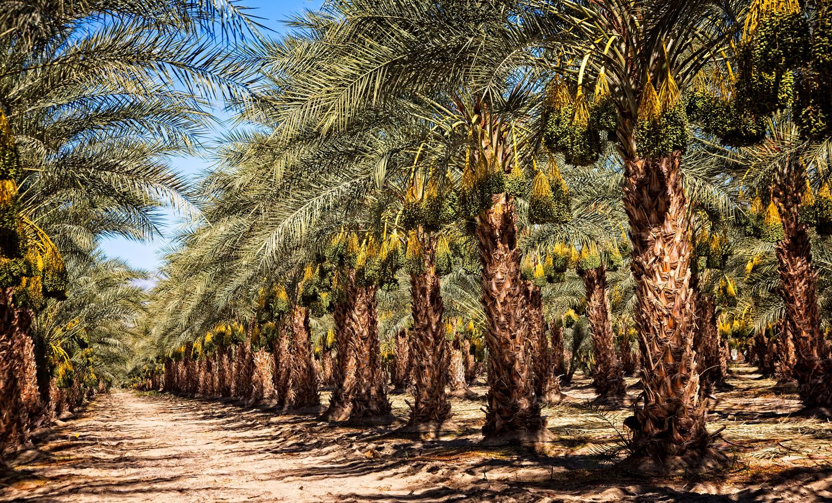
Examples of Plants Adapted to High Temperatures
Fig.4 American aloe
Fig.5 Date palm
8

Slide 9
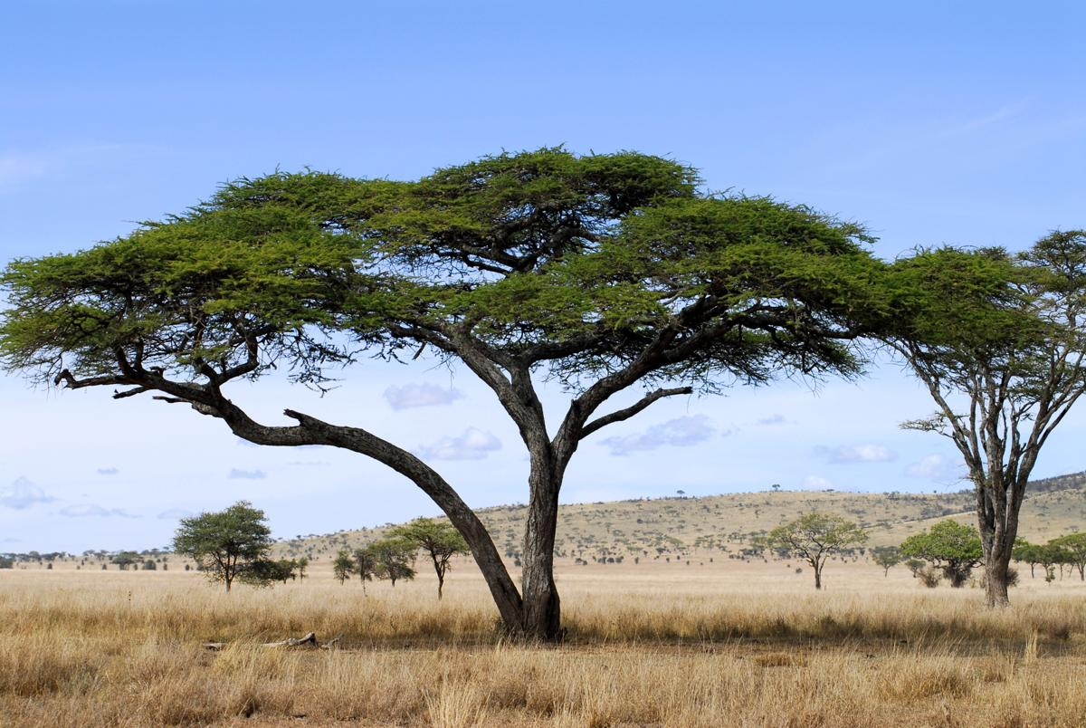
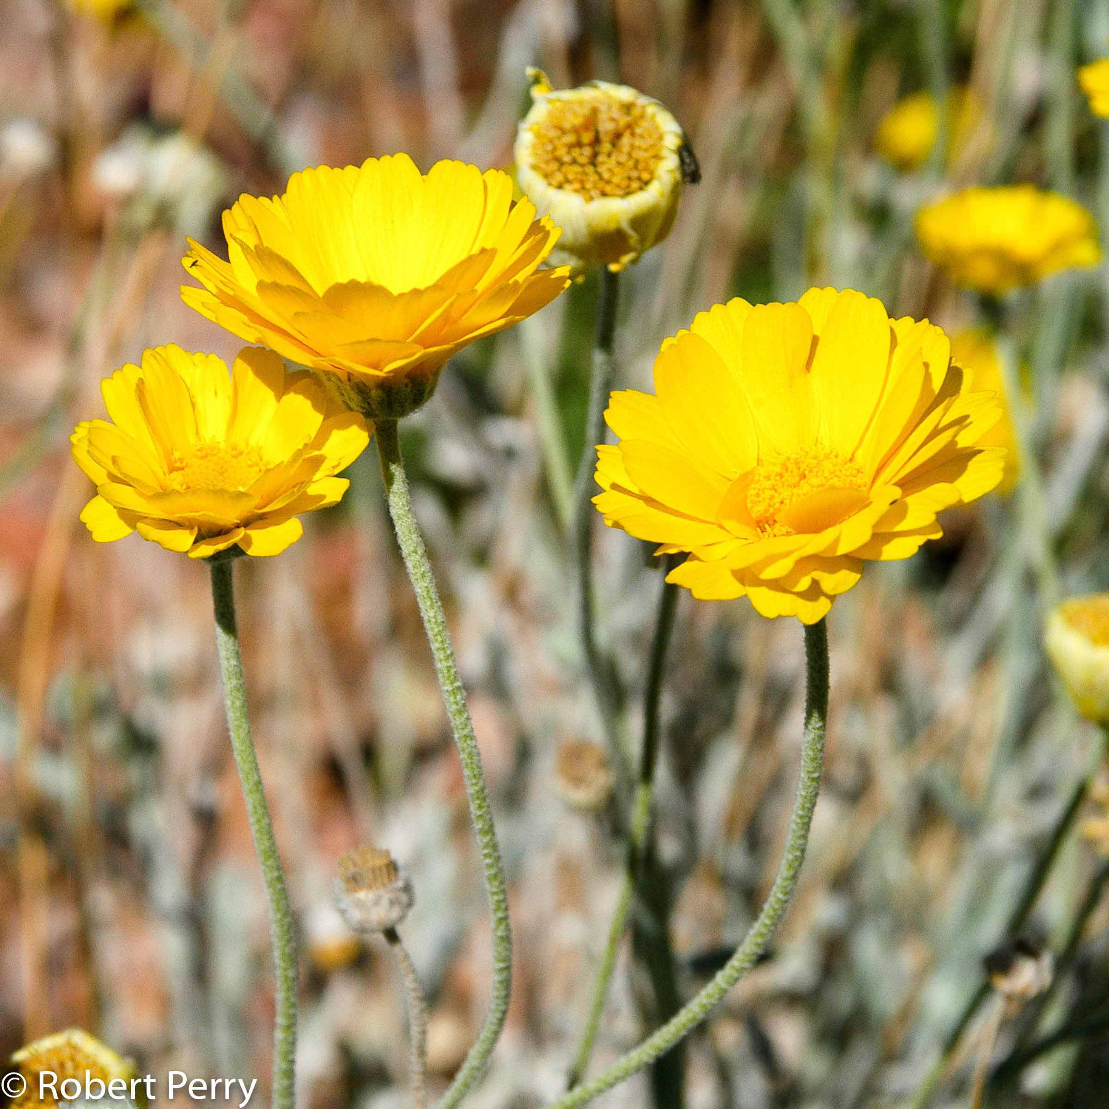
Examples of Plants Adapted to High Temperatures
Fig.6 Acacia trees
Fig.7 Desert marigold
9

Slide 10
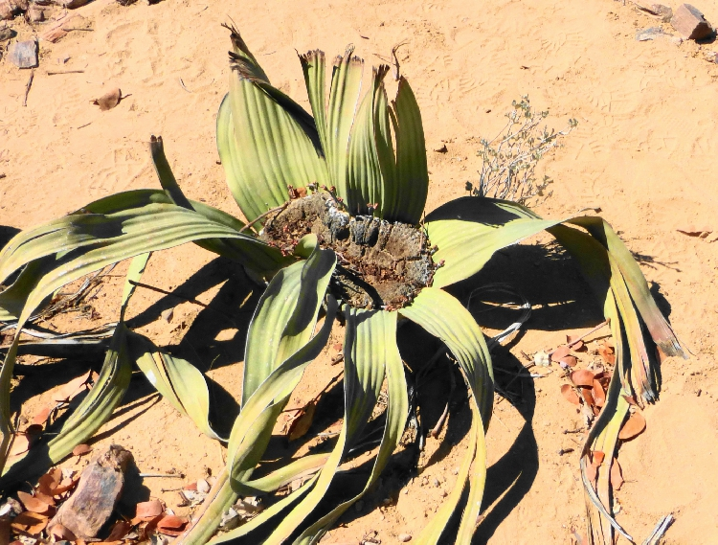
Examples of Plants Adapted to High Temperatures
Fig.8 Opuntia cactus
Fig.9 Welwitschia mirabilis
10

Slide 11
Conclusion
Understanding plant adaptations to high temperatures is crucial for survival, agriculture, ecology, and climate change.
Plants exhibit physiological, structural, and behavioral adaptations to cope with high temperature stress.
These adaptations enable plants to maintain cellular integrity, reduce water loss, optimize light exposure, and withstand extreme heat conditions.
11

Slide 12
References
Wahid, A., Gelani, S., Ashraf, M., & Foolad, M. R. (2007). Heat tolerance in plants: An overview. Environmental and Experimental Botany, 61(3), 199-223.
Mittler, R. (2006). Abiotic stress, the field environment, and stress combination. Trends in Plant Science, 11(1), 15-19.
Suzuki, N., Rivero, R. M., Shulaev, V., Blumwald, E., & Mittler, R. (2014). Abiotic and biotic stress combinations. New Phytologist, 203(1), 32-43.
Zhang, J., Jia, W., & Yang, J. (2018). Is ROS and redox signaling really involved in heat stress response? Trends in Plant Science, 23(4), 349-354.
Valliyodan, B., Nguyen, H. T., & Kumar, R. (2014). Molecular approaches for enhancing heat tolerance in plants. In Advances in Agronomy (Vol. 127, pp. 121-165). Academic Press.
Li, M., Liu, J., Wang, Y., Wang, W., & Liu, Y. (2020). Root system architecture: Insights into the molecular and physiological mechanisms underlying root responses to high temperatures. Journal of Experimental Botany, 71(16), 4831-4844.
Hatfield, J. L., & Prueger, J. H. (2015). Temperature extremes: Effect on plant growth and development. Weather and Climate Extremes, 10(Part A), 4-10.
12

Slide 13

THANK YOU
13

